Slide 1
Personal Finance App
Managing Budgets, Expenses, Income, Savings, and Investments
Group Team Name: Group 4
Presenters: Javaris Johnson and Mirenge Innocent

Slide 2
Problem Statement
"Without a well-organized and user-friendly application, managing personal finances can be difficult. Many people have trouble monitoring their monthly spending plans, income sources, and budgets, which causes stress and makes it harder to reach financial objectives.
"This app fills this gap by providing a complete personal finance management solution. It gives customers a comprehensive picture of their financial situation by assisting them in setting and tracking budgets, keeping track of spending, tracking income, and establishing savings objectives.

Slide 3
Problem Statement
Obstacles Users Face:
Inability to see overall spending trends and costs.
Setting and sticking to monthly budgets can be challenging.
Limited awareness of savings progress and financial goals.

Slide 4
Problem Statement
Target Audience:
People who want to improve their money management.
People who want to save money for investments.
Users who want a straightforward way to track income and expenses.

Slide 5
Requirements
Functional Requirements:
Users should be able to register for an account and safely log in using the app.
Users ought to be able to create a monthly budget and enter their income and expenses.
The app should use the monthly budget and overall costs to determine the remaining budget.
It should be possible for users to view savings targets and track their progress.
For improved financial analysis, create basic reports (e.g., a breakdown of expenses by category).

Slide 6
Requirements
Inputs:
User information: information needed to create an account, such as name, email address, and password.
Income Data: Amount, date, and source of income entries.
Expense Data: Amount, date, category, and description for each expense.
Savings Goals: Target amount and deadline for each goal.
Monthly Budget: Amount allocated for monthly spending.

Slide 7
Requirements
Outputs:
Entire income, entire expenses, and remaining budget are shown.
An overview of every spending item, such as meals and transportation.
Progress toward financial objectives is visualized.
Option to view past data and analyze spending trends over time.

Slide 8

Requirements
Non-Functional Requirements:
The application ought to have an intuitive user interface.
Only the verified user should be able to access the safely stored data.
Even with a lot of data, the software should function effectively, without lag or mistakes.

Slide 9
Solution Overview
Our solution is a personal finance app designed to simplify budgeting, expense tracking, and income management.
With a clean and intuitive user interface, the app provides a seamless experience for users to monitor their financial activities and goals.

Slide 10
Solution Overview
Key Features:
Budgeting: Depending on their overall spending, users can establish a monthly budget and track the leftover sums.
Expense Tracking: Users can log each expense with details like amount, category, and date, making it easy to see where money is being spent.
Income Tracking: Allows users to add different income sources, providing a consolidated view of all income streams.
Savings Goals: Users can set savings goals, such as saving for a vacation or emergency fund, with target amounts and deadlines. Progress toward these goals is displayed.
Reporting: Provides simple data visualization and summaries to help users understand their spending habits, savings progress, and overall financial health.

Slide 11
Solution Overview
Technologies Used:
Flutter: The app may function seamlessly on both iOS and Android thanks to Flutter's cross-platform interoperability.
SQLite: A lightweight database that allows for quick data retrieval and offline access to financial data stored locally.
Provider Package: For effective handling of user data and app state, this package is used for state management.

Slide 12
Solution Overview
Benefits of the Solution:
Gives customers real-time information about their spending and savings, enabling them to take charge of their money.
Promotes goal-oriented saving and financial restraint.
Provides a private, safe, and offline-compatible alternative for managing personal finances.

Slide 13
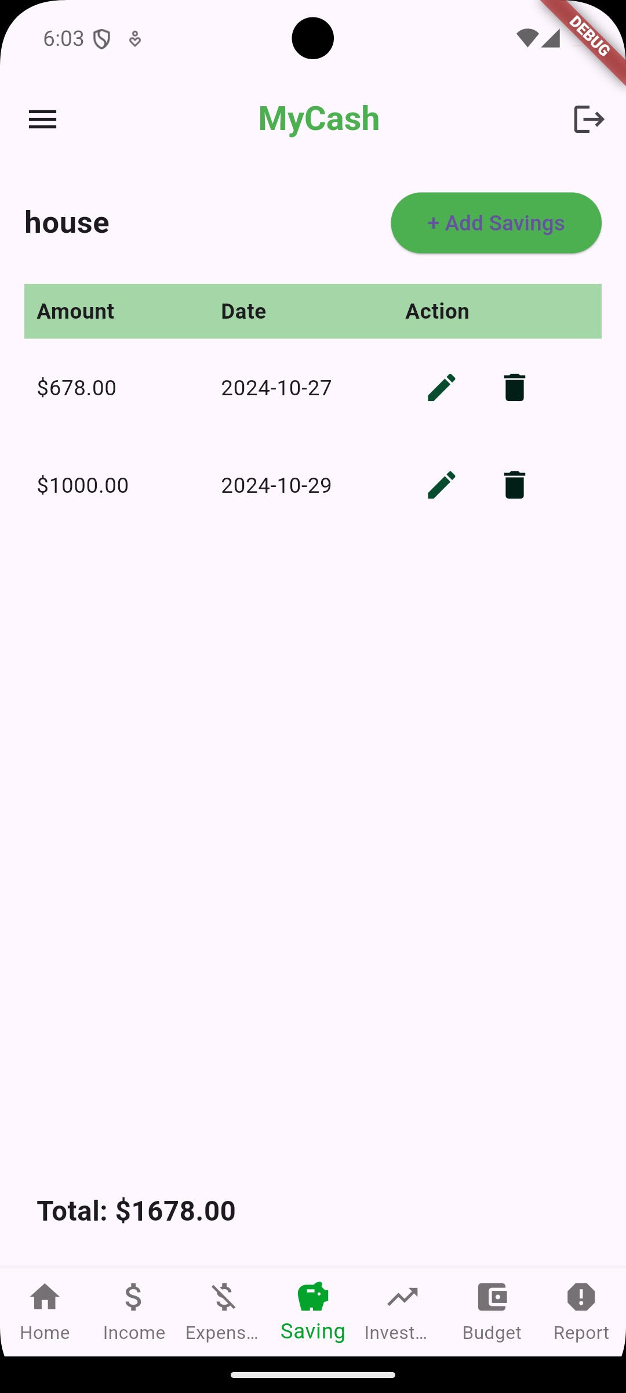
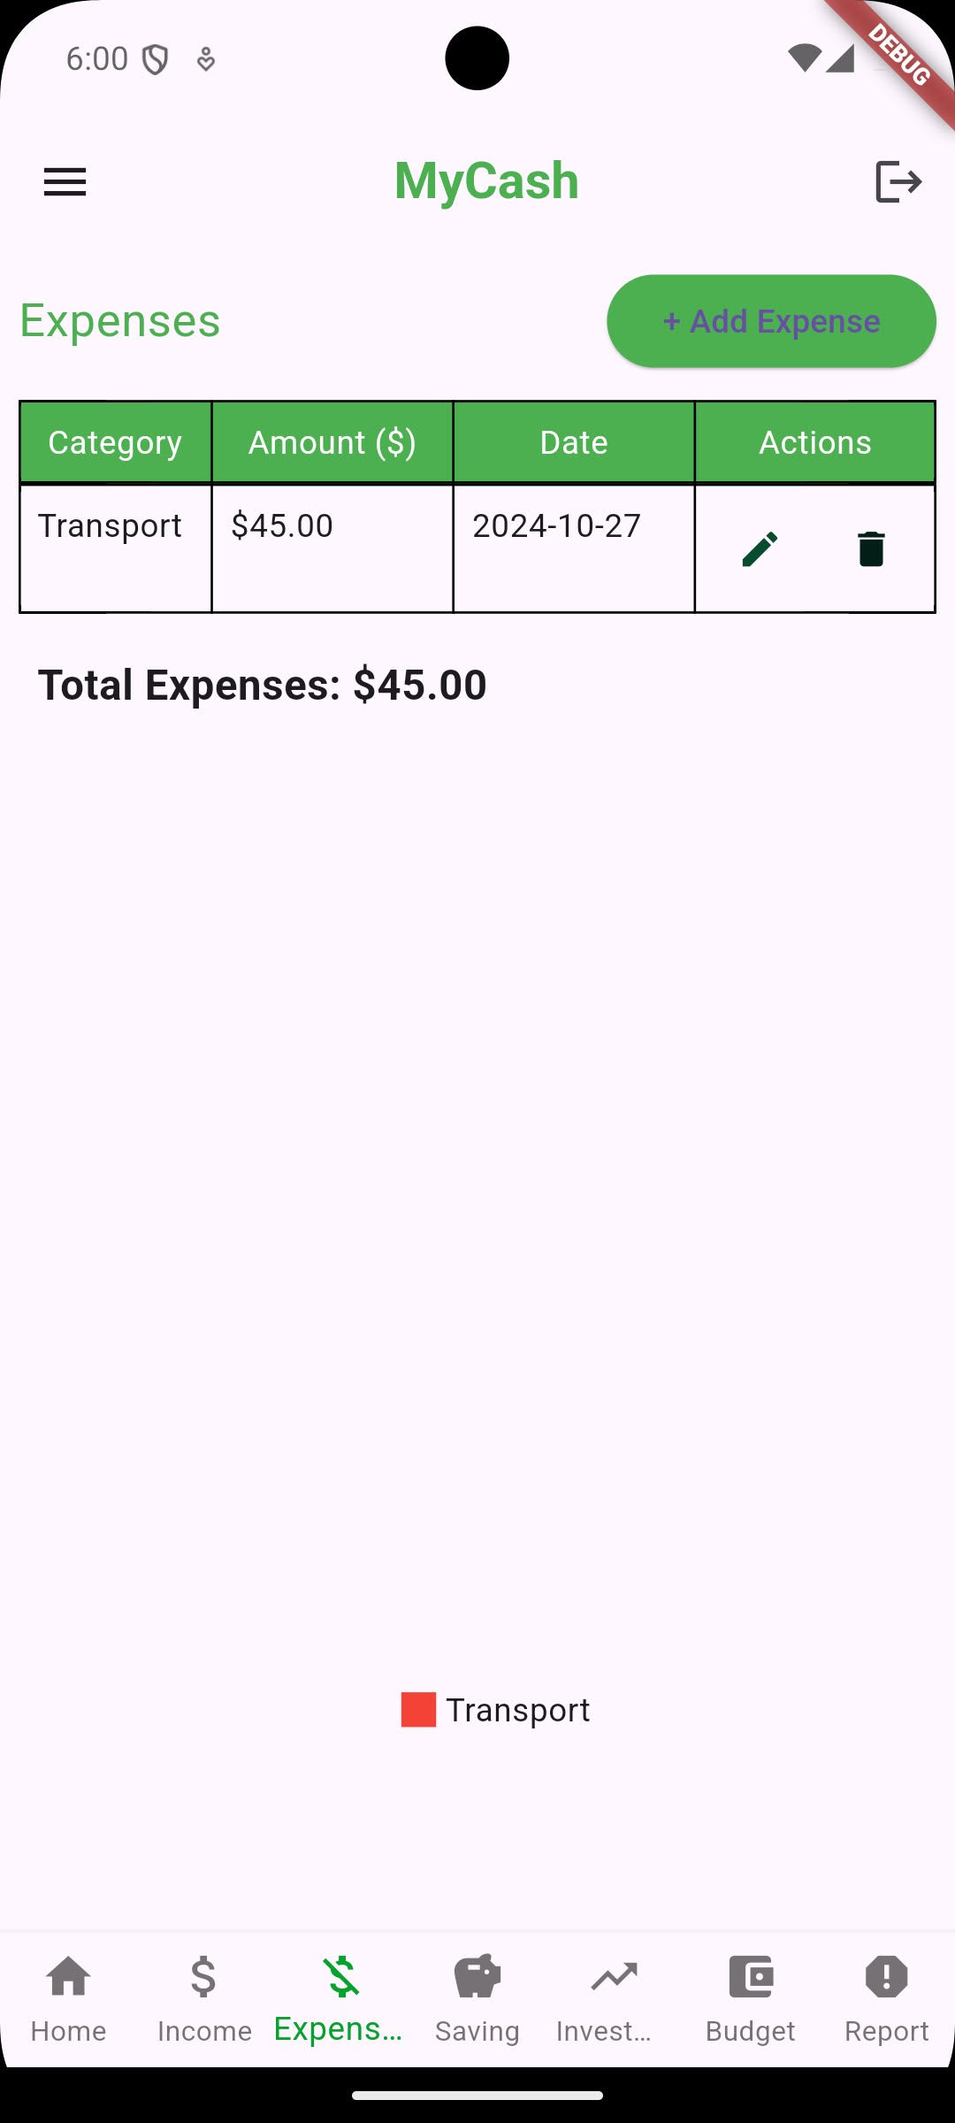
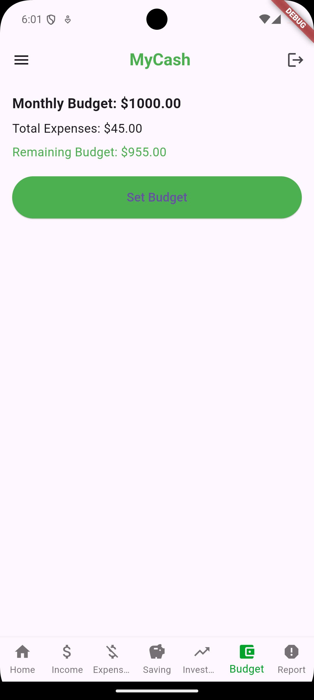
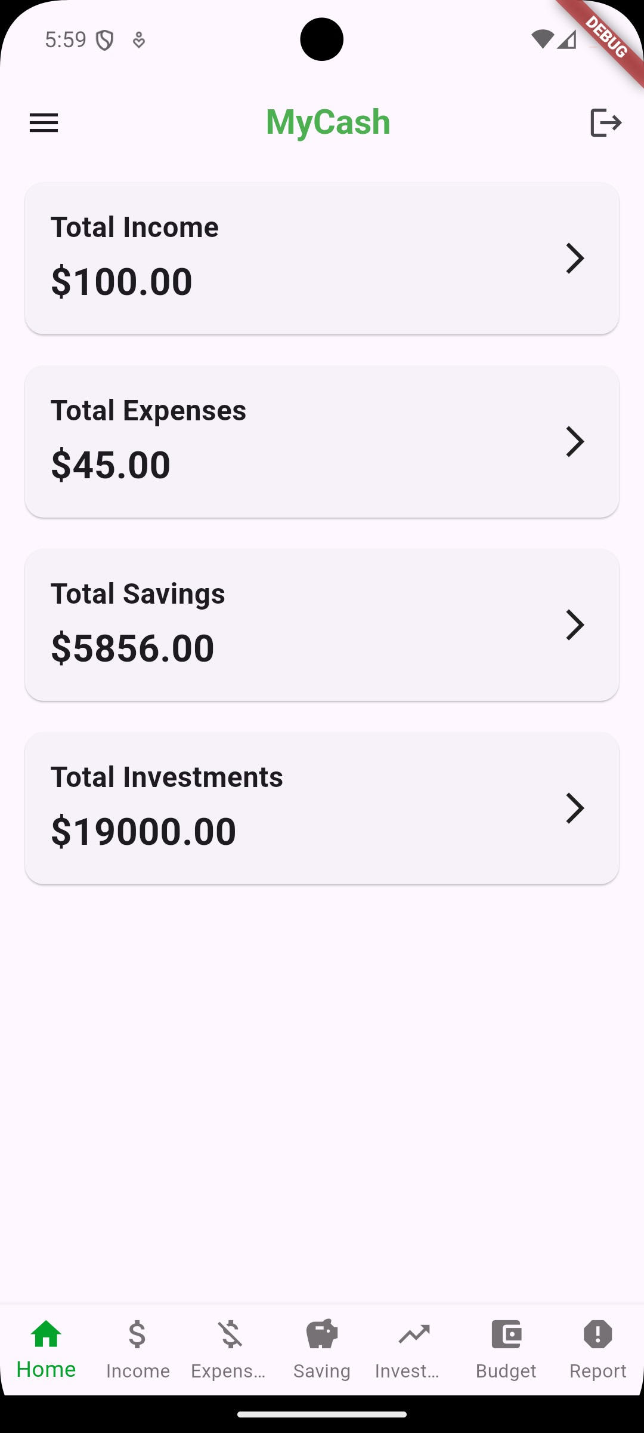
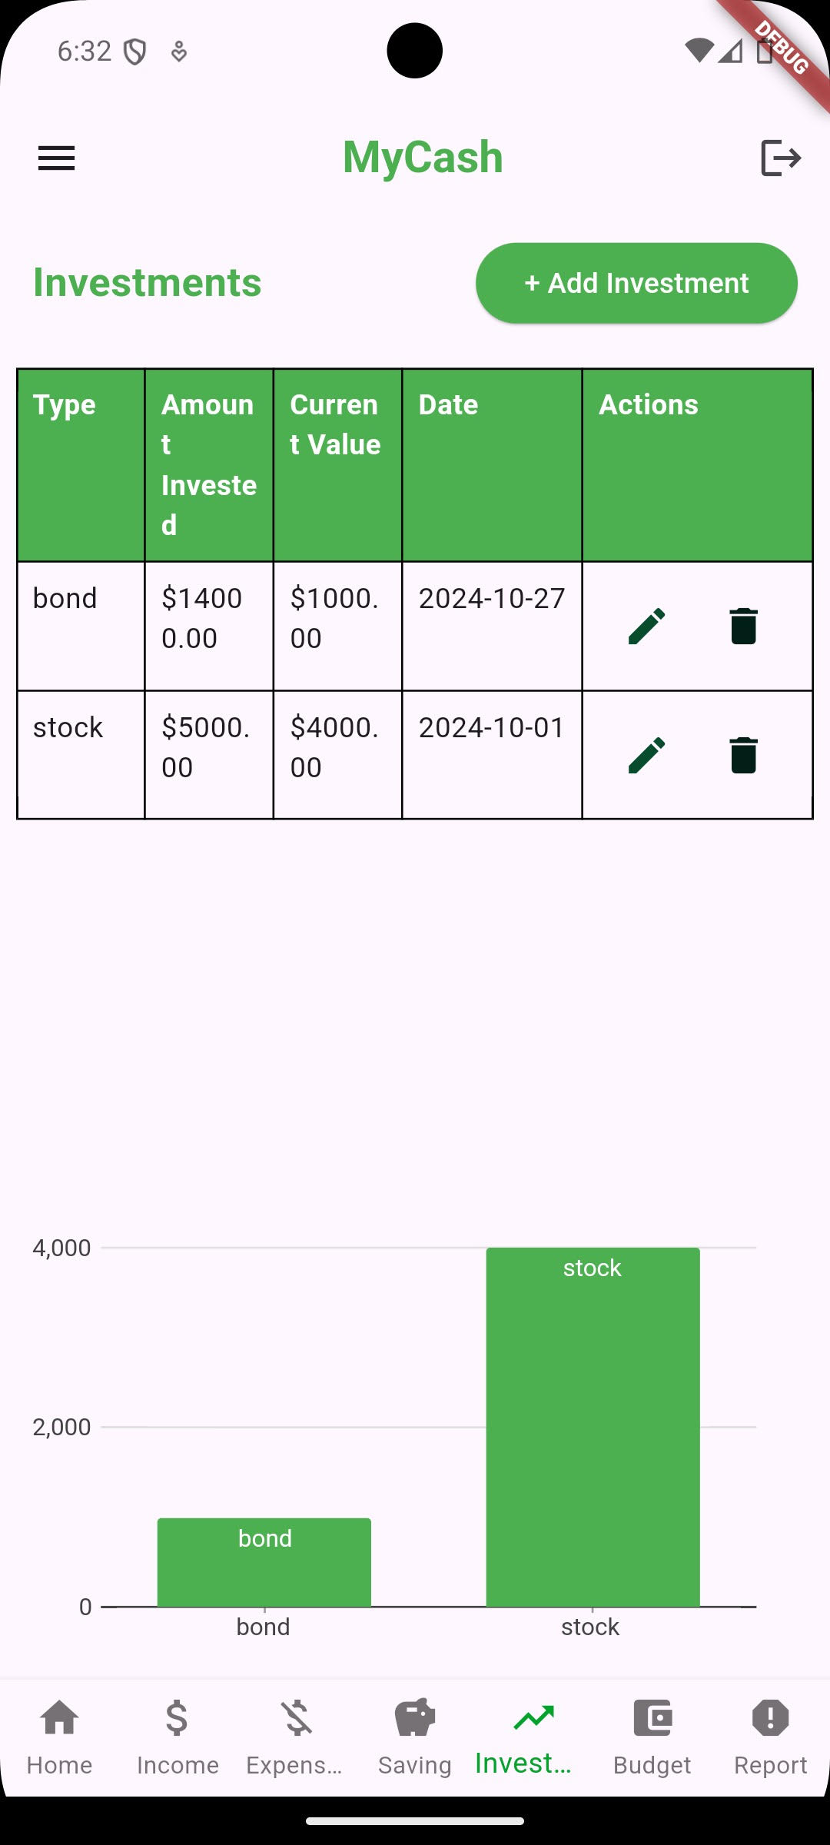
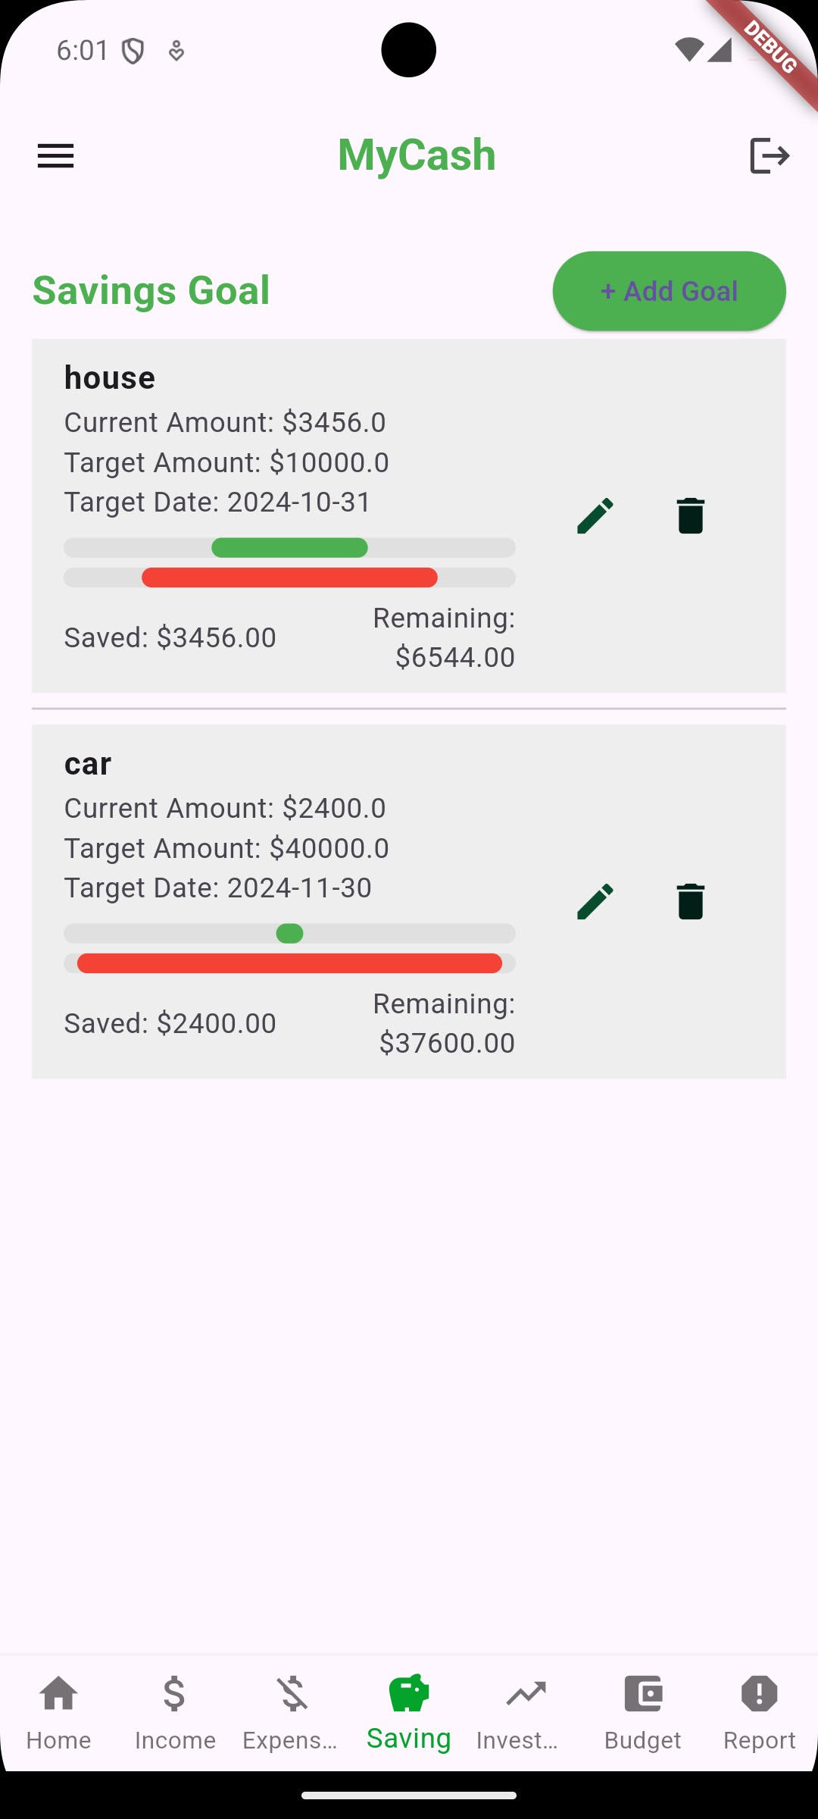
User Interface Overview
“With a simple layout enabling simple navigation, the design places a high priority on usability.”

Slide 14
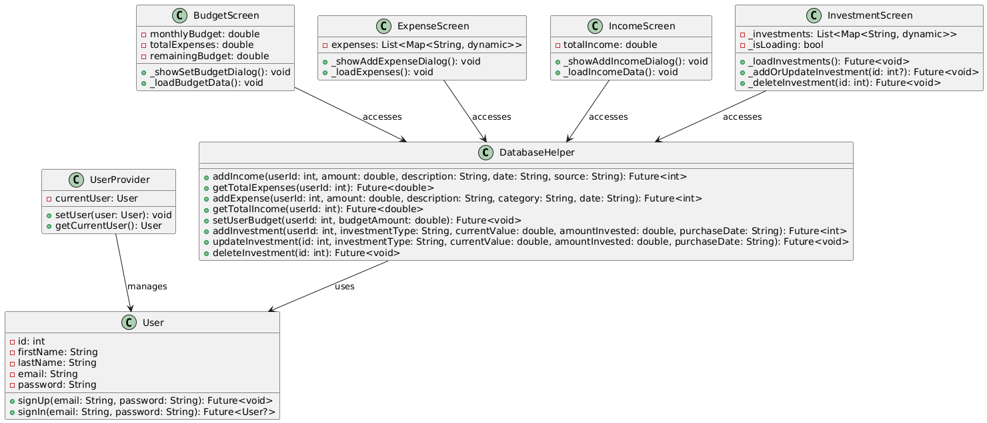
UML Class Diagram
“The links between the main classes in the application, such DatabaseHelper and UserProvider, and displays, like BudgetScreen, ExpenseScreen, and IncomeScreen, are depicted in the UML diagram.”
“Each screen represents a key function of the application, DatabaseHelper controls data storage, and UserProvider handles user data.”

Slide 15
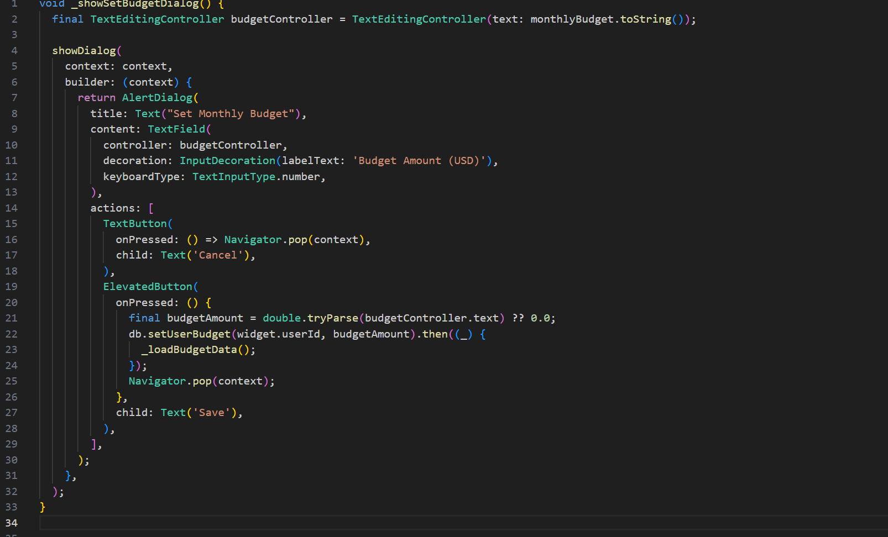
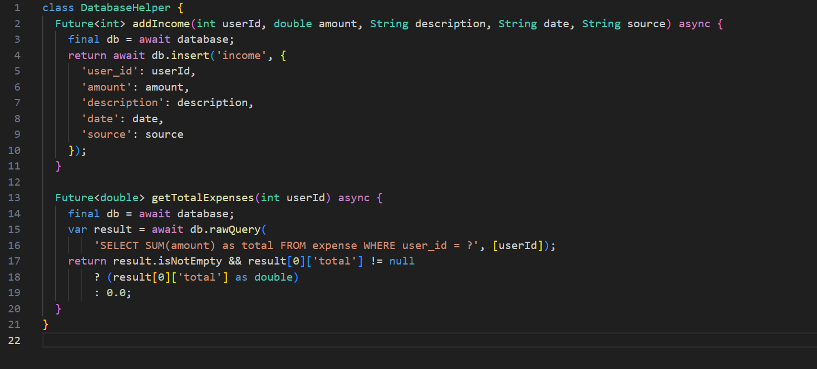
Pseudo Code and Key Functions
Key Functions and Pseudo Code
Set Budget Functionality
Database Helper Methods

Slide 16
Testing and Troubleshooting Process
We tested how the app components work together by verifying data flows, such as ensuring that when a new expense is added, the budget screen updates to reflect the remaining budget accurately.
Example: If a user sets a monthly budget, the remaining budget should update in real-time after an expense is added.

Slide 17
Testing and Troubleshooting Process
We also performed manual testing to simulate user interactions. This included testing on an emulator for navigation across screens, data entry, and visual checks to ensure a user-friendly interface.“
Example: "We checked if input forms worked well with valid and invalid data, such as empty fields or incorrect amounts, to make sure appropriate error messages appeared."

Slide 18
Testing and Troubleshooting Process
Continuous upgrades and troubleshooting were part of our testing procedure to make sure all features worked without a hitch. User interface testing, problem fixes, and functionality verification were important testing stages.

Slide 19
Testing and Troubleshooting Process
We created sample data for each module to verify calculations. Any issues found during testing were tracked and logged, and bugs were fixed promptly to ensure smooth functionality.
Example: "One issue identified was inaccurate budget updates when expenses were logged in quick succession. We addressed this by adding data validation checks."

Slide 20
Testing and Troubleshooting Process
Key Troubleshooting and Updates:
Initial Functionality Testing (Oct 12-21):
"We focused on getting all routes to work correctly, ensuring that navigation between screens like Home, Budget, and Income functioned as expected.“
Commit: adding all the files (Oct 21, 2024) established the initial project structure.

Slide 21
Testing and Troubleshooting Process
"An issue was identified with the Budget button not being clickable on the emulator. After investigating potential causes, updates were made to the button configuration to ensure it was functional.“
Commits:
Bdgt button test and Budget button fix (Oct 25, 2024) - Initial troubleshooting and adjustments.
Updated the button so it is now clickable (Oct 26, 2024) - Successfully resolved the interaction issue.

Slide 22
Testing and Troubleshooting Process
Enhanced Route Testing and Bug Fixes (Oct 22-26):
We also performed route testing to confirm all paths functioned across screens. Fixes were applied to ensure error-free transitions, and additional debugging refined route configurations for user actions like budget and investment updates.“
Commits:
All the routes are working (Oct 26, 2024) - Confirmed stable routes across all screens.
Update database helper and screens; fix methods and routes (Oct 25, 2024) - Refined screen functions and route handling.

Slide 23
Testing and Troubleshooting Process
Functionality and User Interface Finalization (Oct 27):
"The last round of testing involved finalizing new features like investments and ensuring the database helper methods functioned properly. This phase also included visual checks to maintain UI consistency.“
Commit:
New functionalities added (Oct 27, 2024) - Integrated all remaining functions and performed final testing.

Slide 24
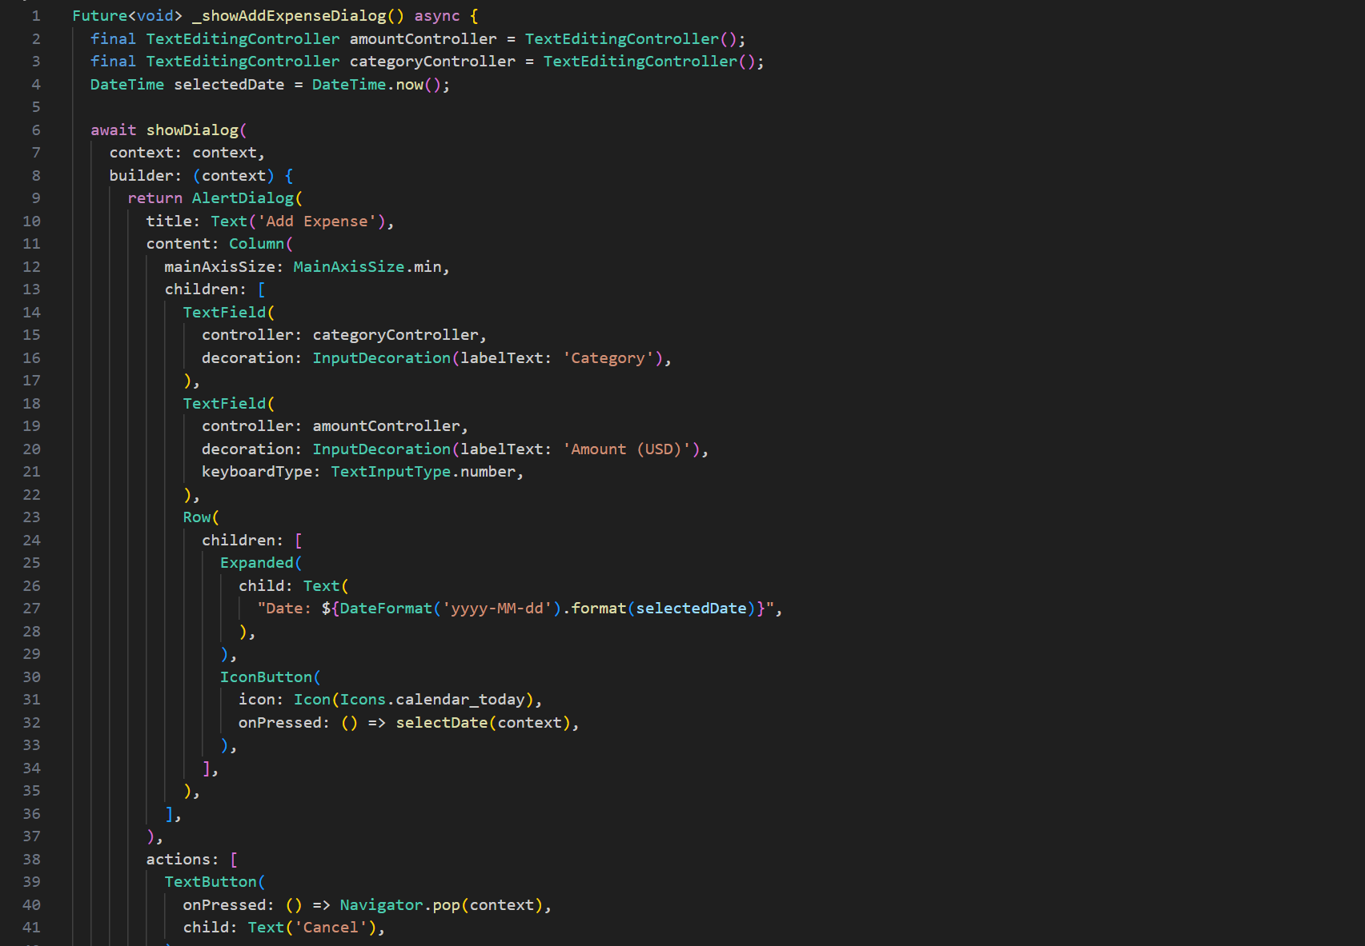
Additional Snippet
Adding Expenses

Slide 25
Conclusion
The goal of the Personal Finance App project was to provide a dependable, easy-to-use application for monitoring and controlling personal money, including income, spending, investments, and budgeting.

Slide 26
Conclusion
Key Achievements:
Created a thorough financial management application that makes it simple to access and track income, spending, savings, and investments in one location.
To provide safe access and data management, a user authentication system was put in place, enabling users to safely save and access their financial data.
Clickable buttons, real-time data updates, and simple navigation improved the user experience and made the app more approachable and interesting.

Slide 27
Conclusion
Challenges and Resolutions:
Interaction and Navigation: Focused debugging and button configuration changes resulted from early issues with the Budget button's operation, guaranteeing constant interaction.
Data Integration and Management: To ensure data integrity and ease of retrieval, structuring techniques for each financial component was necessary while implementing database operations in the DatabaseHelper.

Slide 28
Conclusion
Future Enhancement:
Extending analytics capabilities to incorporate expenditure trends and insights for better financial planning.
Cross-device compatibility through speed optimization enables smooth platform usage.

Slide 29

Conclusion
Takeaways:
The significance of thorough testing and debugging for a seamless user experience was highlighted by this project.
The app's development brought to light the need of organized data management and modular architecture, particularly when combining various financial elements.

